Slide 1
User Guide
CustomFDS

Slide 2


How to install requirements.txt
Step 1 :
Firstly freeze all pip packages in the requirements.txt file using :
Step 2:
Install the requirements.txt file using:
Step 3:
Confirm manually that all requirements are installed on the system.

Slide 3
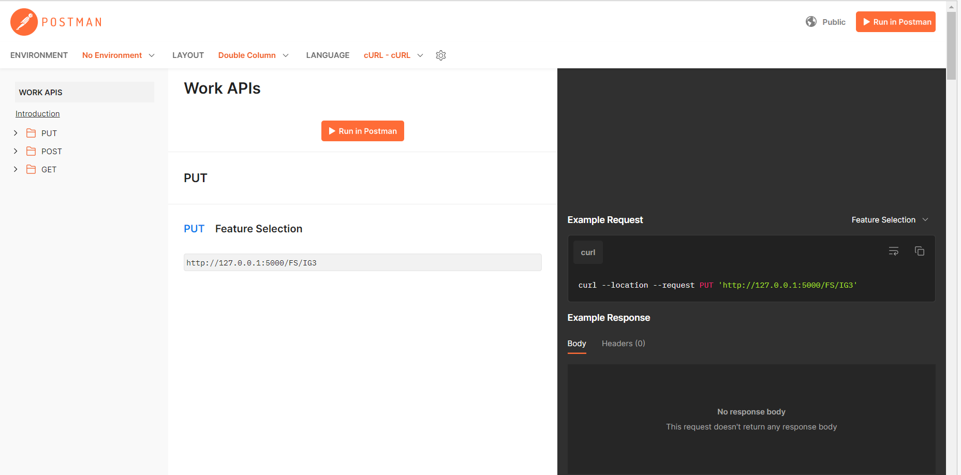
How to get the postman API’s to use
1
Open the Postman link provided in the Github Repository
Click here

Slide 4
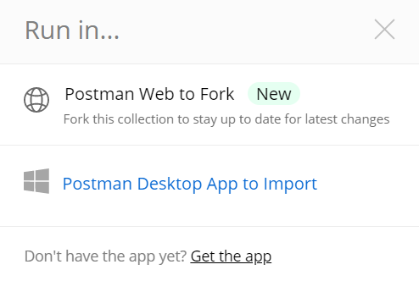
2
Choose any of the suitable option

Slide 5
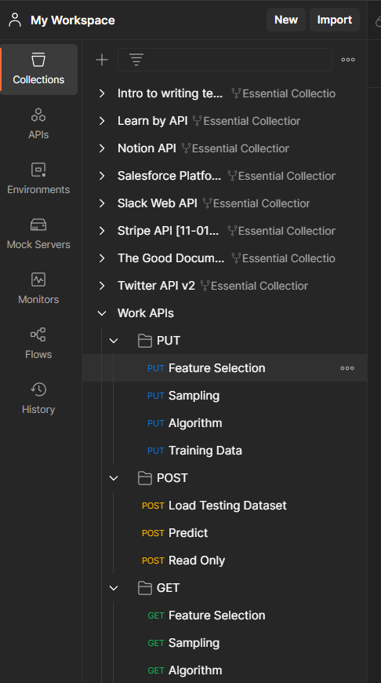
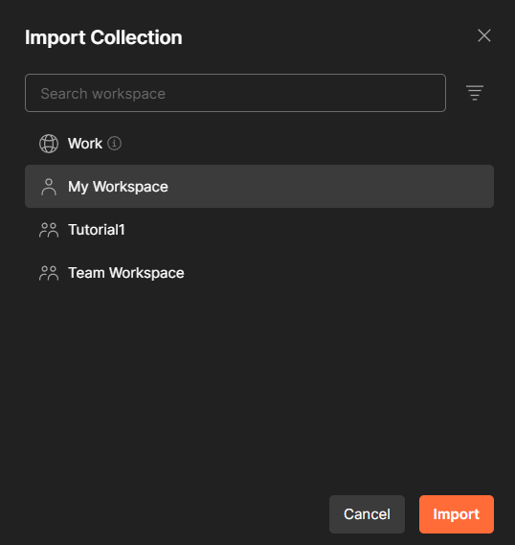
3.a
If you choose “Postman Desktop App to import”
Your desktop app will open and you have choose the place to import the collection
This is how it looks like after importing
Choose and then click on Import, your collection will be imported

Slide 6
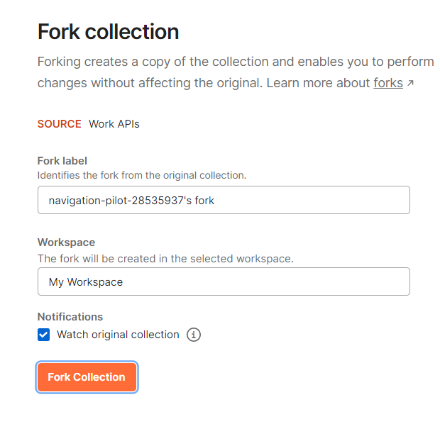
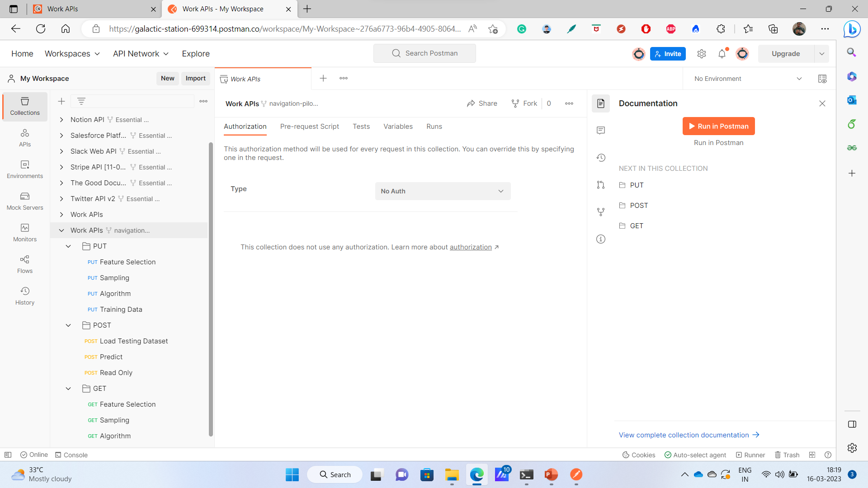
3.b
If you choose “Postman Web to Fork”
A login page for postman will appear, login to your postman account. Choose the workspace and fork the collection to get your collection
This is how it looks like after fork call
Choose and then click on Import, your collection will be imported

Slide 7
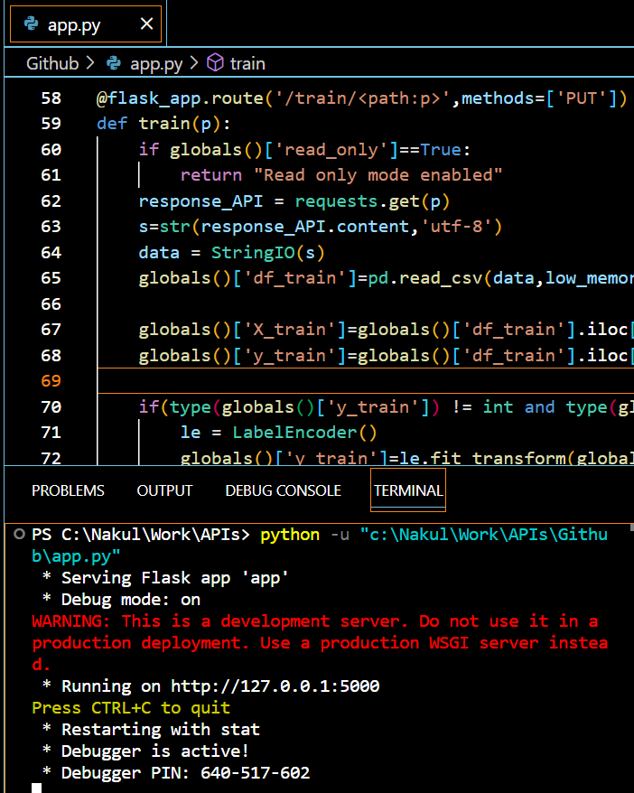
How to use the API’s and the customFDS
1
Run the app.py on your system to get the link of the server
You can use any platform to run the code to get the link of the server. Its an example of VSCode.
If its deployed on the central server then no need to run the code and the link of central server could be used instead.
Link of the demo host

Slide 8
Note
We will use the host link to make all the API calls
Copy and save the host link, as it will be used further to make the API calls
For example, in the given guide the link for host server is:
http://127.0.0.1:5000

Slide 9
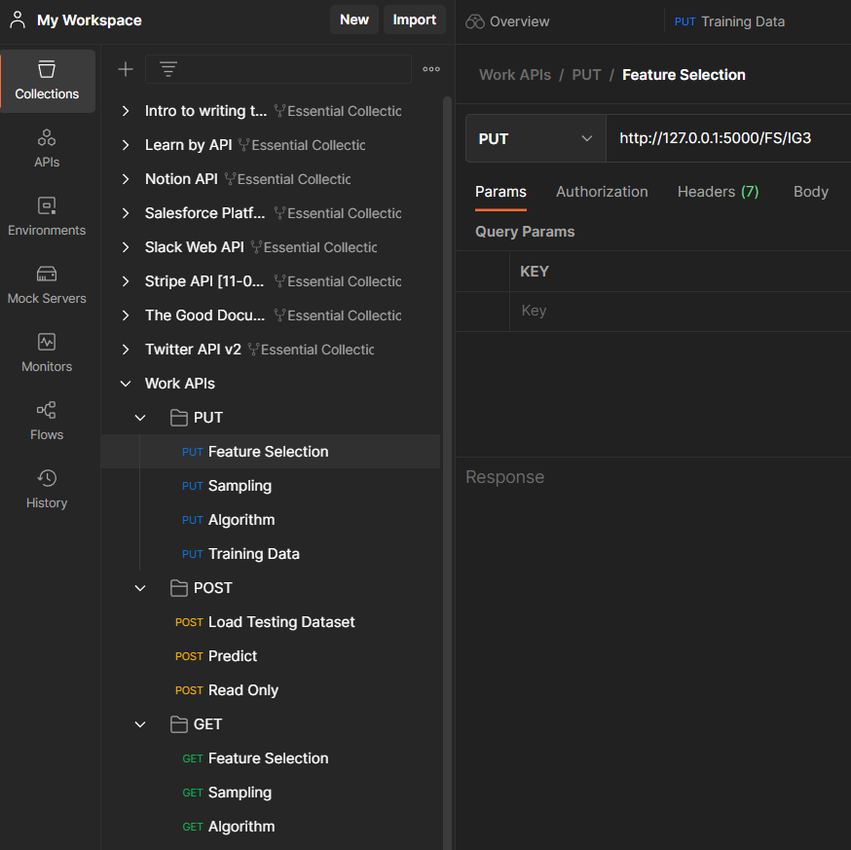
2
Select the feature selection technique from PUT request along with number of features
How to make the API link:
Server link/FS/FS technique name and number of features required
For example:
http://127.0.0.1:5000/FS/IG15

Slide 10
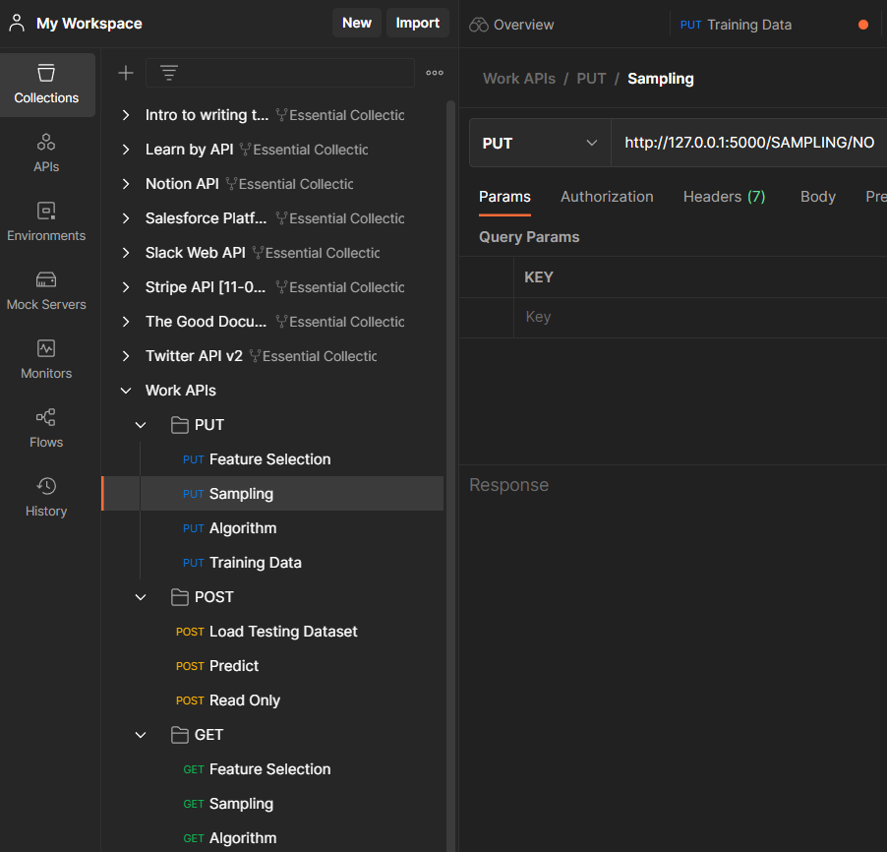

3
Select the Sampling Technique from PUT request and the type of Sampling required
How to make the API link:
Server link/SAMPLING/Technique Name
For example:
http://127.0.0.1:5000/SAMPLING/NO

Slide 11
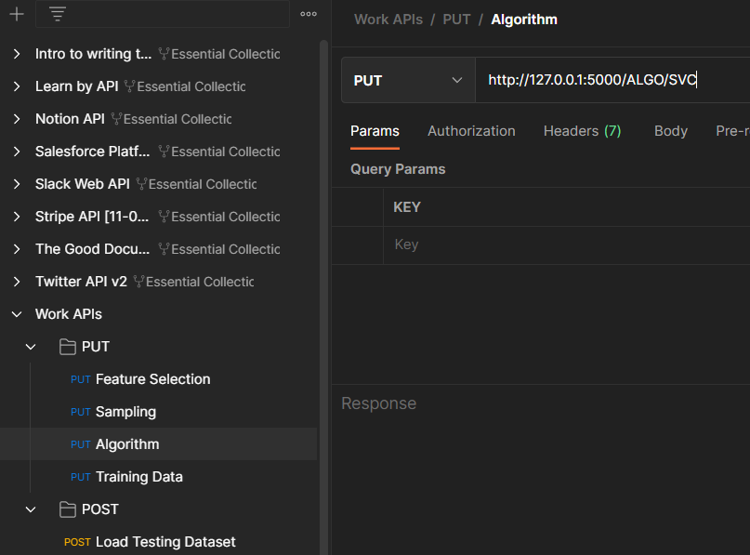

4
Select the Algorithm from PUT request
How to make the API link:
Server link/ALGO/Technique Name
For example:
http://127.0.0.1:5000/ALGO/SVC

Slide 12
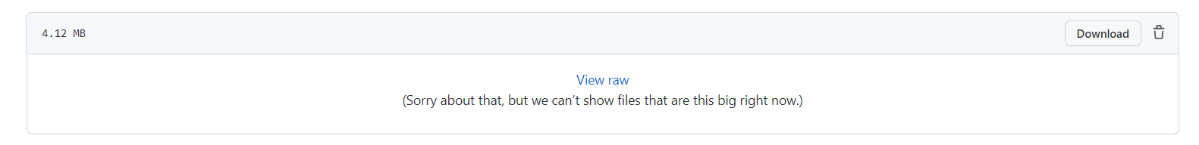
5
Getting the training data link
Click on the training data of GitHub repository
Click on View raw
Copy the link of raw file

Slide 13
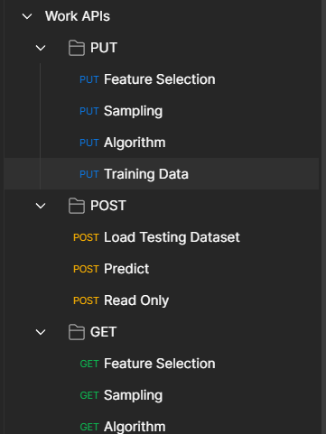
5
Running the “Training” API of PUT request
As mentoined in the API, well add “/train” at the end of the link and the paste the link to raw dataset
Step 5.a
Select Training Data under PUT section first
How to make the API link:
Server link/train/dataset link
For example:
http://127.0.0.1:5000//train/https://raw.githubusercontent.com/nbharot/CustomFDS/main/Training%20data.csv
Add the API link to the right hand side of window. This is how the link would look like
Step 5.b
Choose and then click on Import, your collection will be imported
Output after running train API

Slide 14
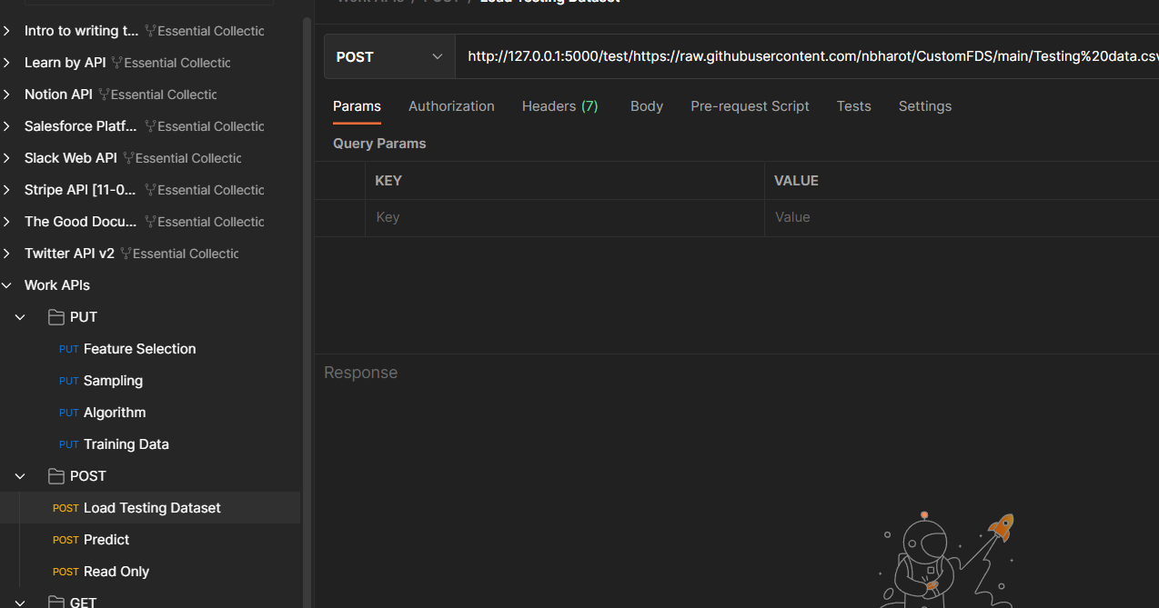
6
Load the Testing Data from POST request
How to make the API link:
Server link/test/dataset link
For example:
http://127.0.0.1:5000/test/https://raw.githubusercontent.com/nbharot/CustomFDS/main/Testing%20data.csv

Slide 15
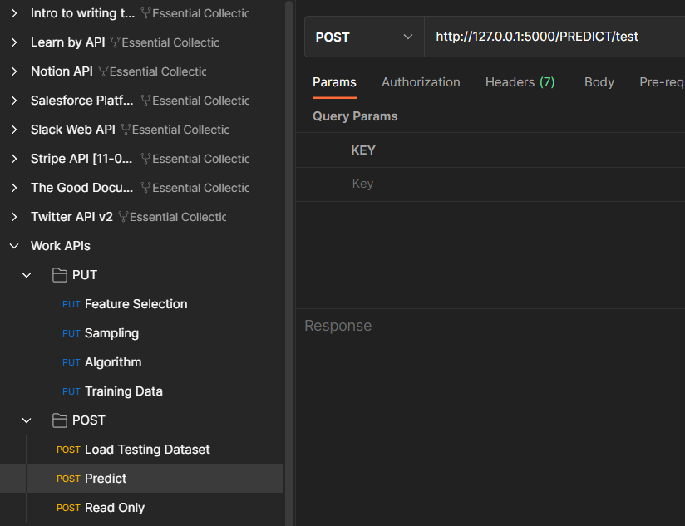

7
Use the Predict API from POST request to get prediction on testing data
How to make the API link:
Server link/PREDICT/test
For example:
http://127.0.0.1:5000/PREDICT/test

Slide 16
Other Functionalities
Feature Selection
(GET Request)
PREDICT
Read Only
It gives you detail of FS technique
Algorithm
(GET Request)
Sampling
(GET Request)
It gives you detail of Algorithm technique
Instead of only testing on test data, custom input feature (comma separated) could be added to get outcome
It helps to lock the FS, Sampling and Algorithm. After running this API, no changes could be made in selected methods
It gives you detail of Sampling technique

